Slide 1

Billing Portal
Notes:
Hello,
We are pleased to to be able to now share with you a billing portal where we can securely deliver all of your billing files each month.
In this short video we will explain how to gain access to our billing portal and what information is available in the portal for you to see.

Slide 2
Access to the Billing Portal
To gain access to the billing portal please email billing@wearepragma.co.uk with a request.
Notes:
To ensure we are setting up the correct people with access to the billing portal we are asking our partners to email billing@wearepragma.co.uk with a request for set up. The Pragma billing team will then create a secure customer log in account and you will receive an actional email:
If you bill both Candio and Pragma products, you will need access to two separate portal accounts.

Slide 3
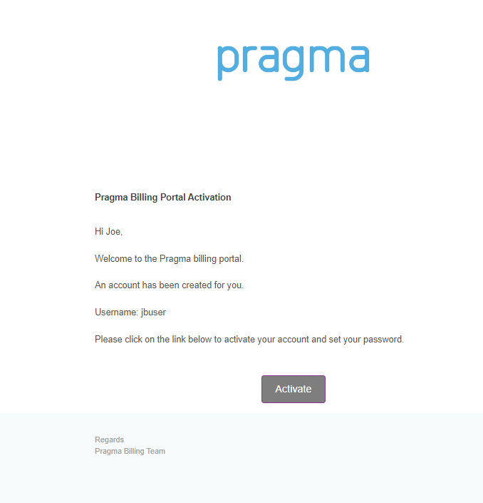
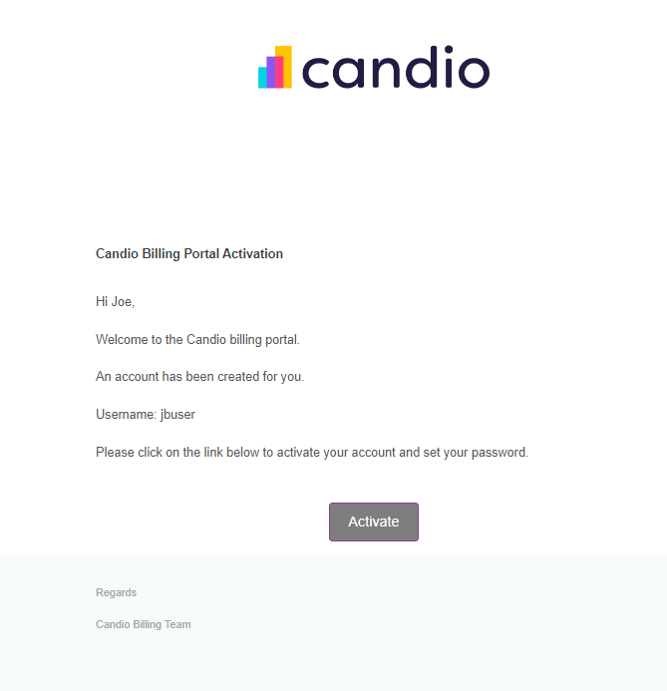
Access to the Billing Portal
Notes:
The activation emails will come from billing@wearepragma.co.uk
You will be asked to click on the activate link and set yourself a password.
Once that is all done, you will be able to log in to the billing portal.

Slide 4
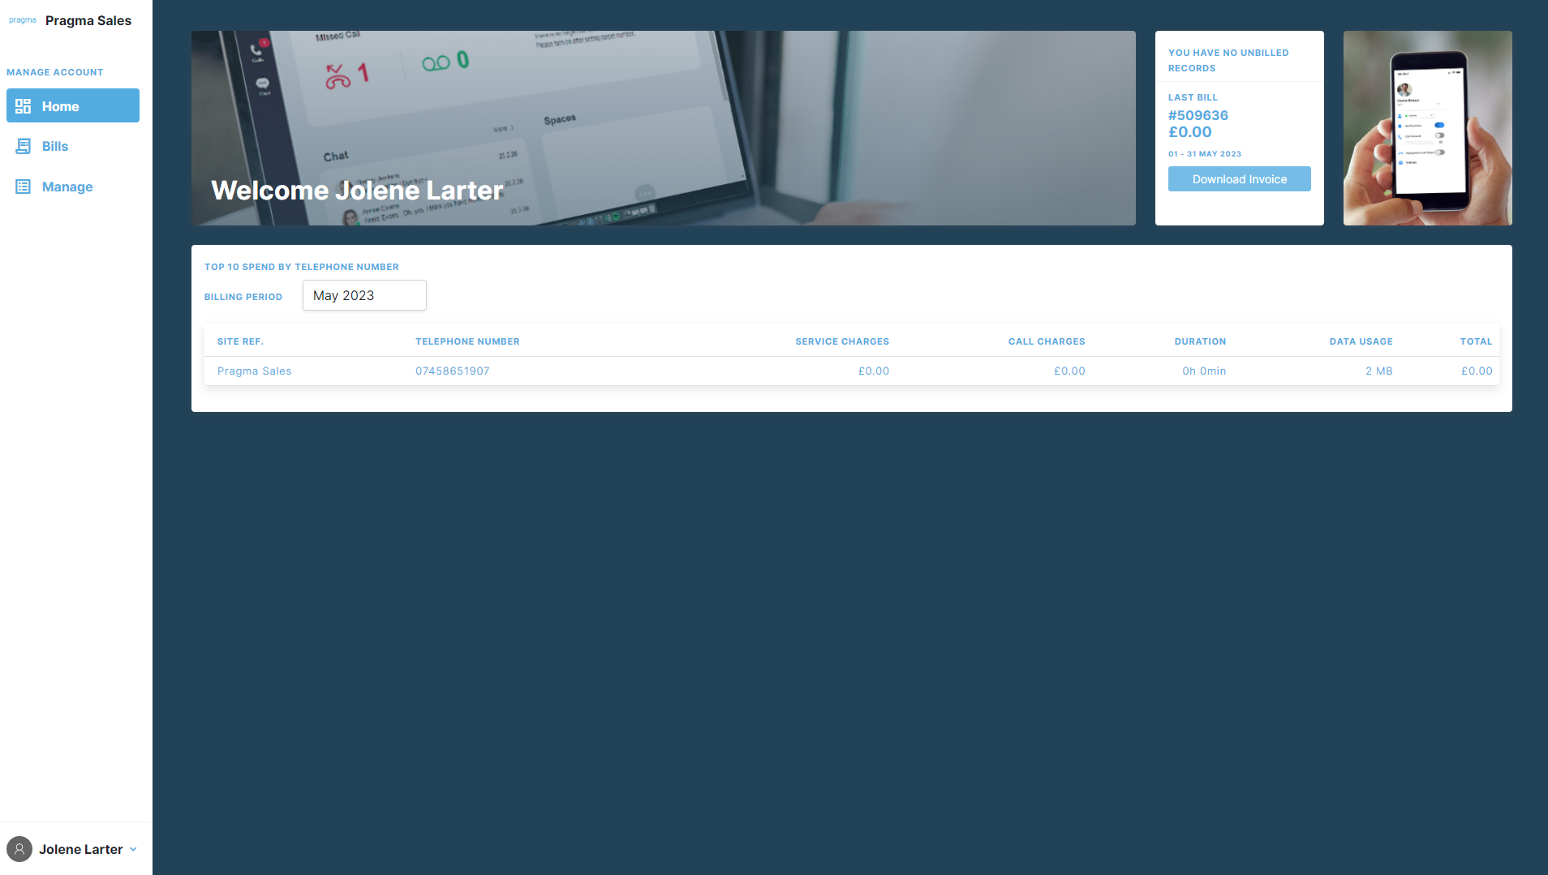
Billing Portal
Notes:
Once logged in you will see this home screen. In this screen you can see your top 10 spend by telephone number and view high level information on your last bill as well as download your invoice from the top right-hand corner.

Slide 5
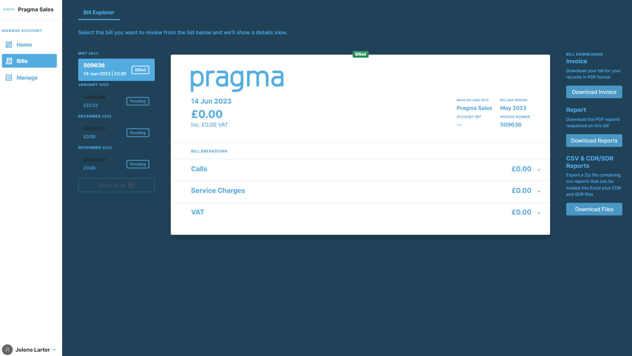
Access to the Billing Portal
Notes:
In the Bills menu, you can view past and present invoices and download your reports and files from the right hand side options.

Slide 6
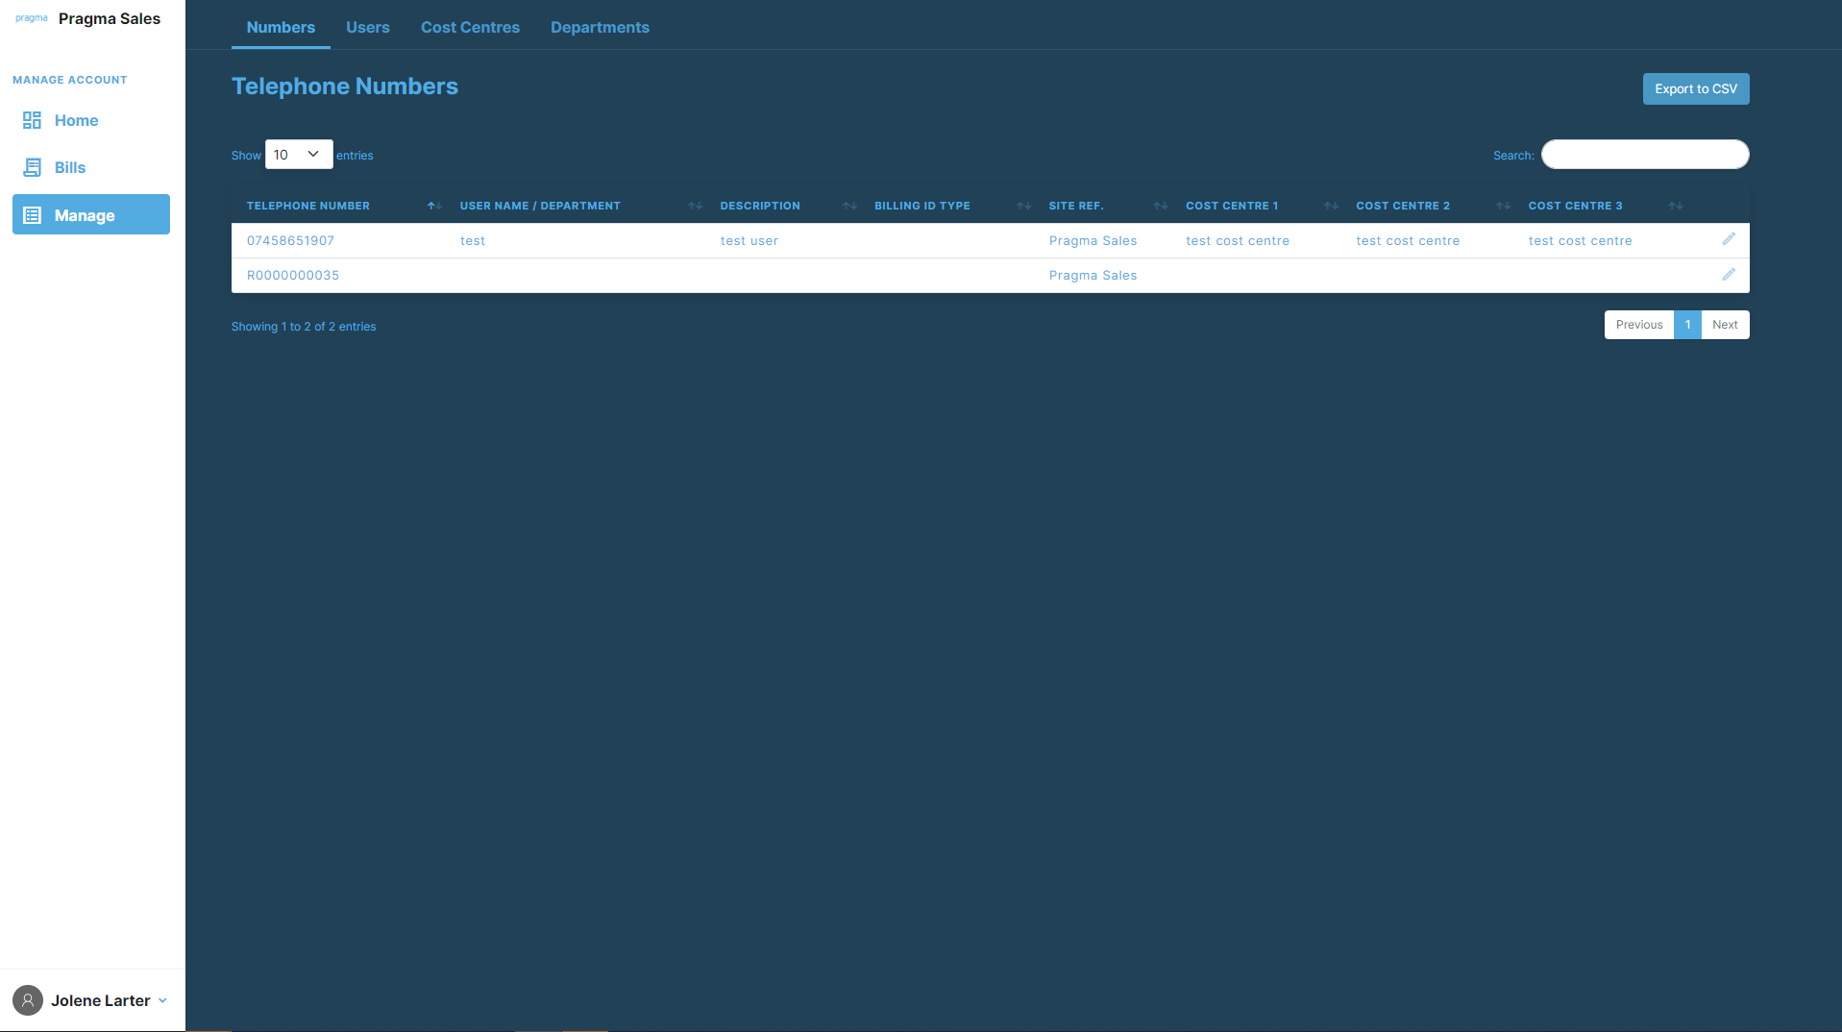
Billing Portal
Notes:
In the Manage menu, you can add usernames and cost centre information to the telephone numbers we are billing.

Slide 7
Billing Portal
Notes:
To manage your telephone numbers, you need to create your Users, Cost Centres & Departments in the relevant tab menus across the top.

Slide 8
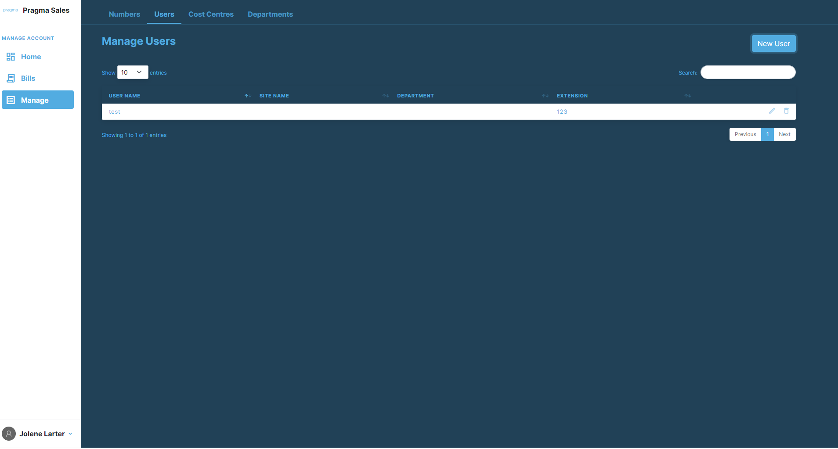
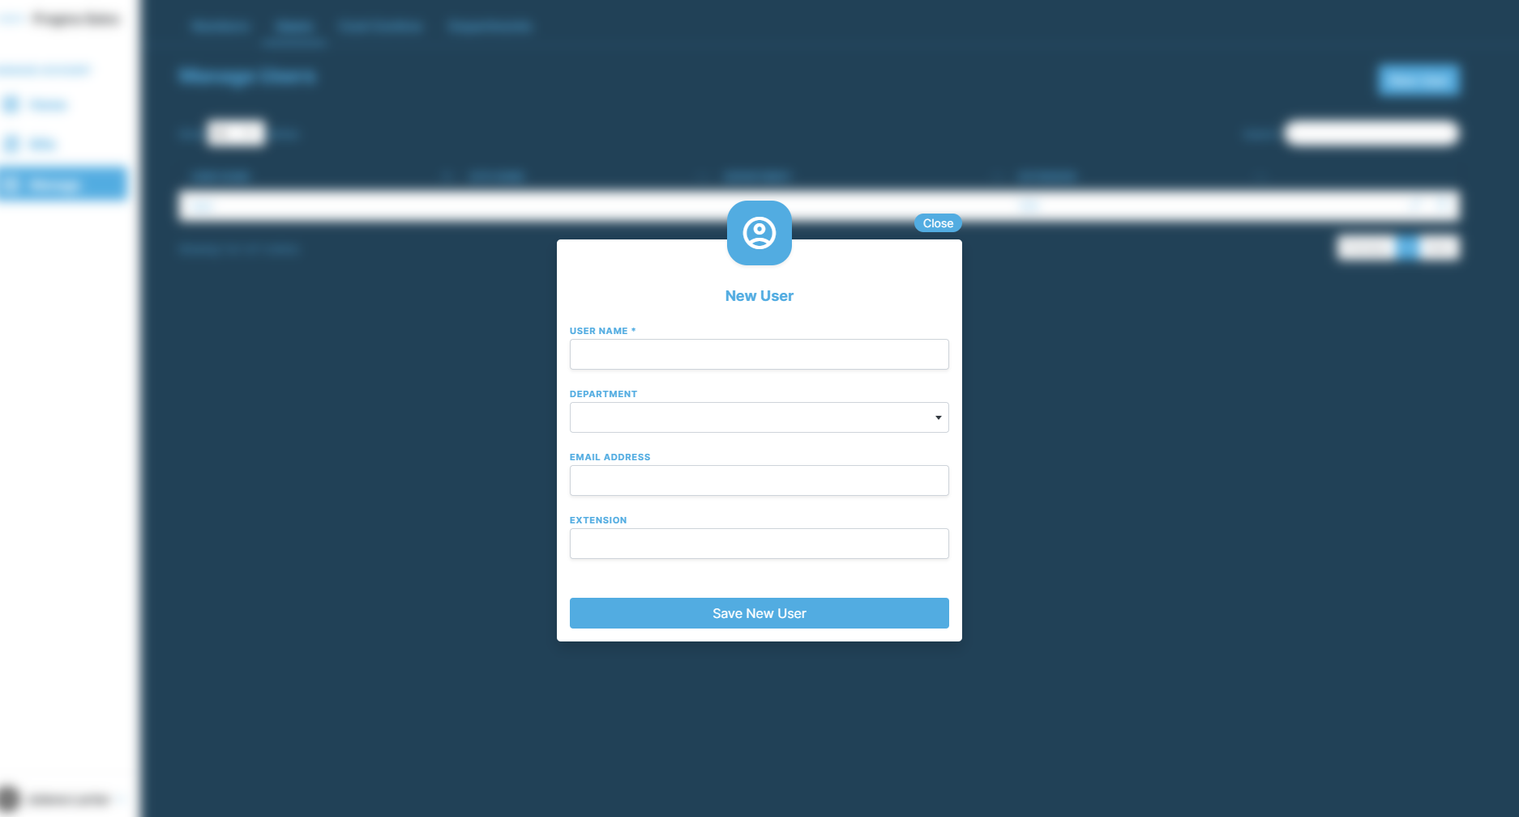
Billing Portal
Notes:
For Users, click on Users along the top and then create user. You will then see a pop up box for you to enter your user information. You will only see department options in the drop down menu if you have created them already.

Slide 9
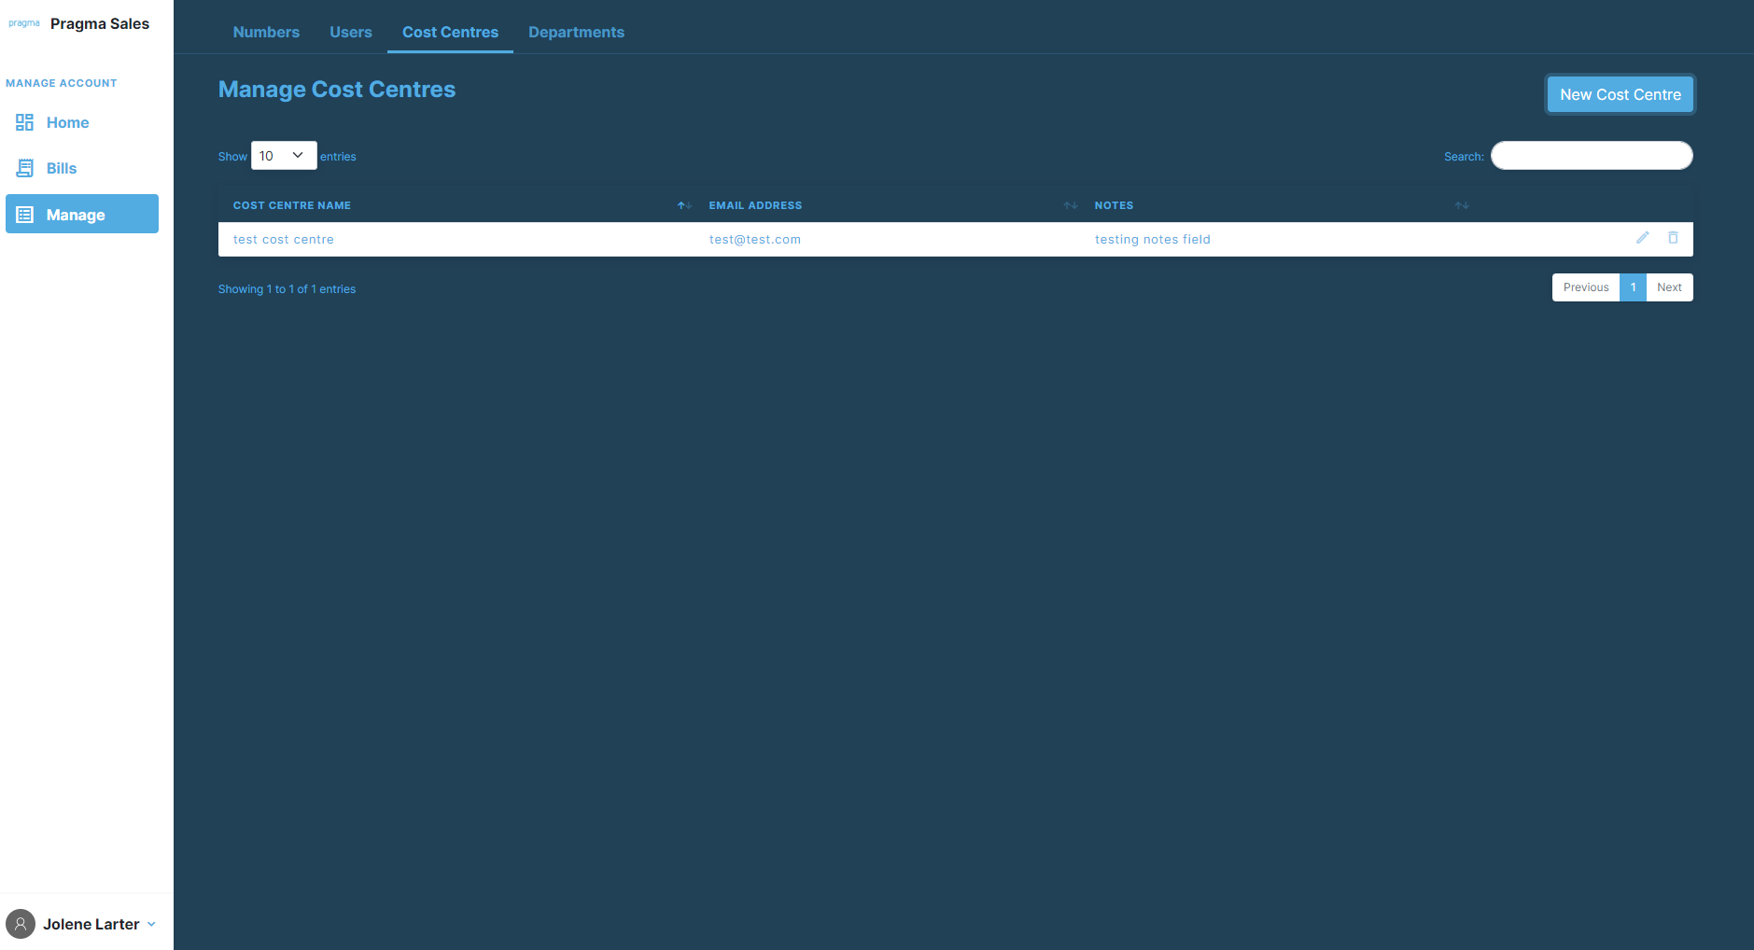
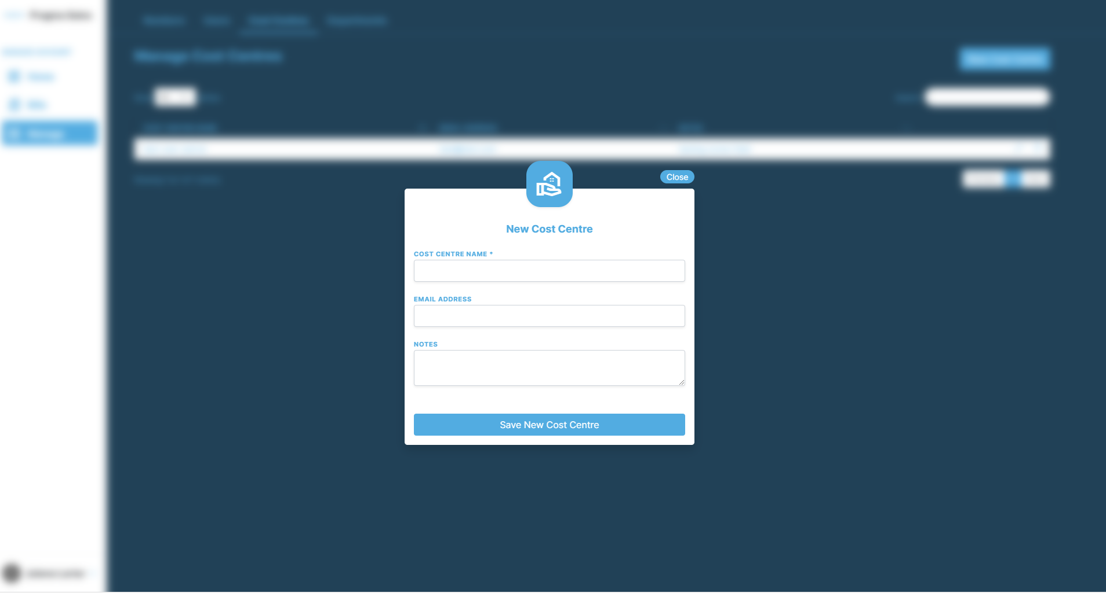
Billing Portal
Notes:
The same for cost centre, you move to the cost centre menu along the top and then click to add new cost centre

Slide 10
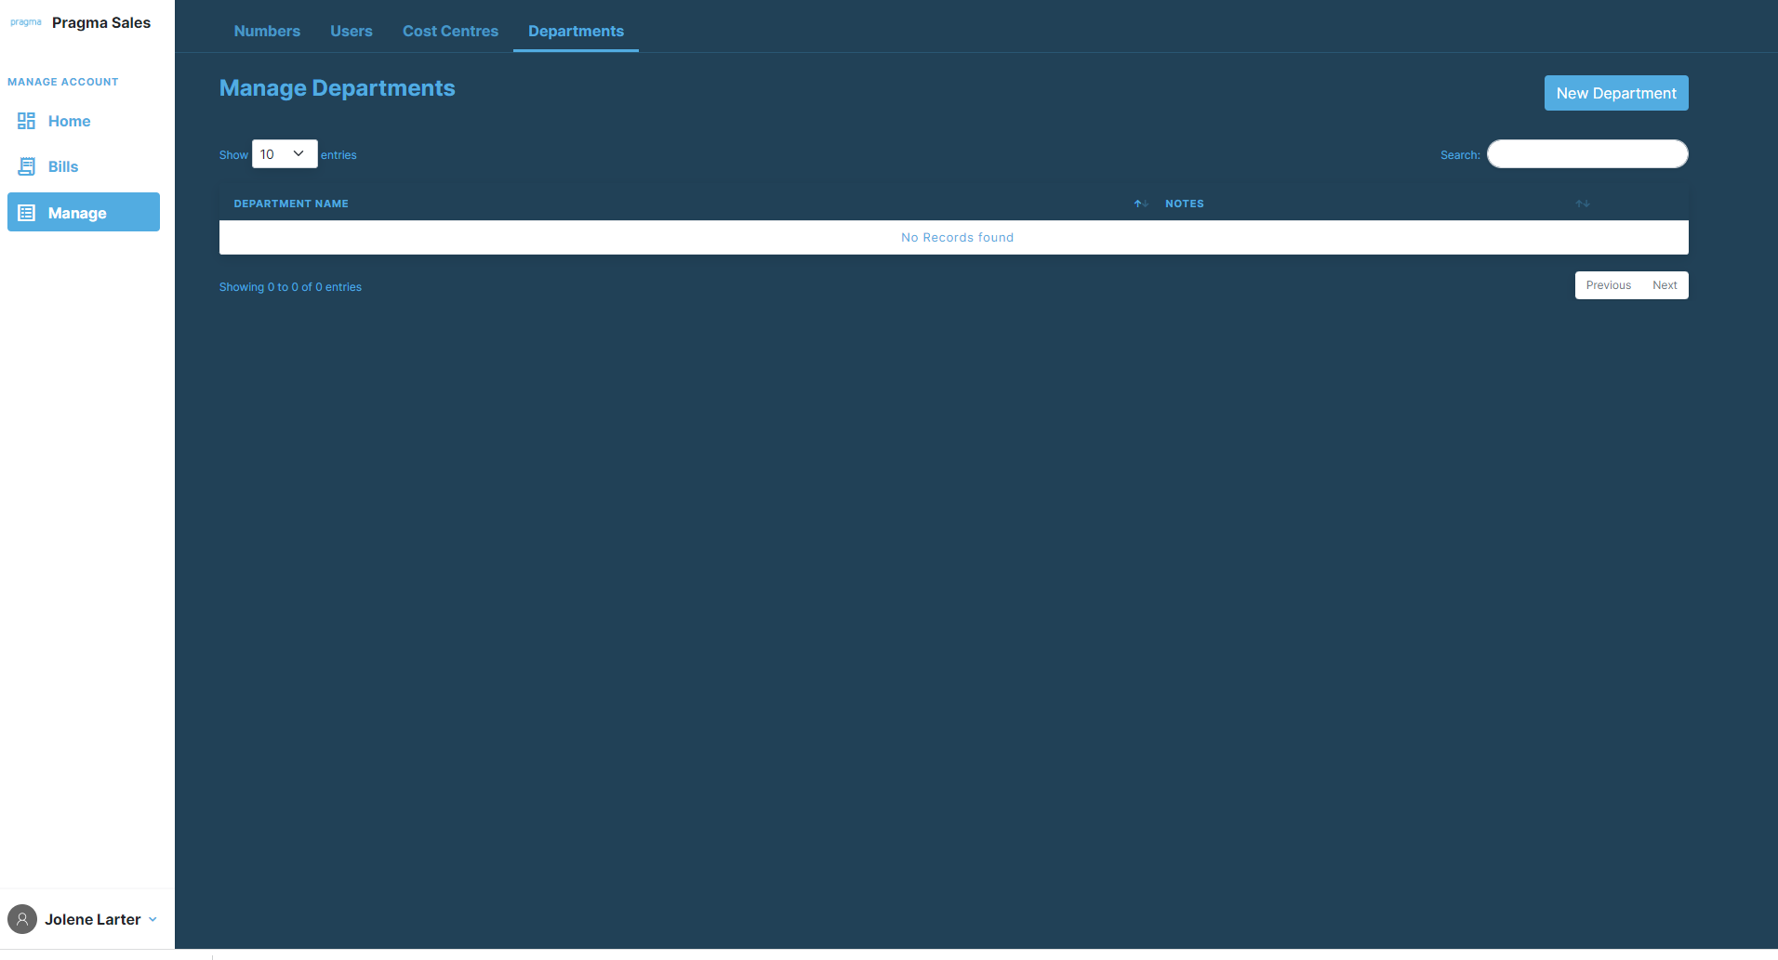
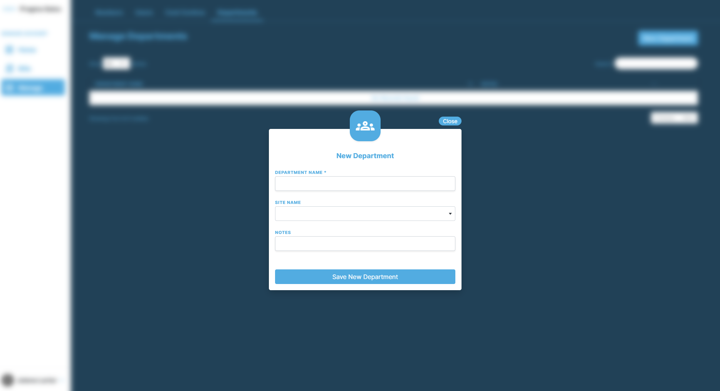
Billing Portal
Notes:
And it’s the same then for Department. As mentioned earlier, if the department or cost centre you are looking for is not available when you create the user, you might need to first create this in the cost centre or department menu.

Slide 11
Thank you
Contact us:
​To contact the Billing Team for both Pragma & Candio:
  Call on 01903 927100 and select the billing option on our auto attendant.​
  Send an email at billing@wearepragma.co.uk
Notes:
We hope you find the billing portal and this training video helpful. If you have any questions, please let us know by contacting the billing team as shown on this slide.

