Slide 2
iCALL Extensions
iCall suite automatically detects when extensions or users are added on the cloud portal.
Anything in the iCALL suite under EXTN type that is called EXTENSION will be invoiced as an end point licences. When creating new extensions, please ensure that these are labelled correctly as one of the other available options (e.g. ACD group) or they will incur charges.

Slide 3
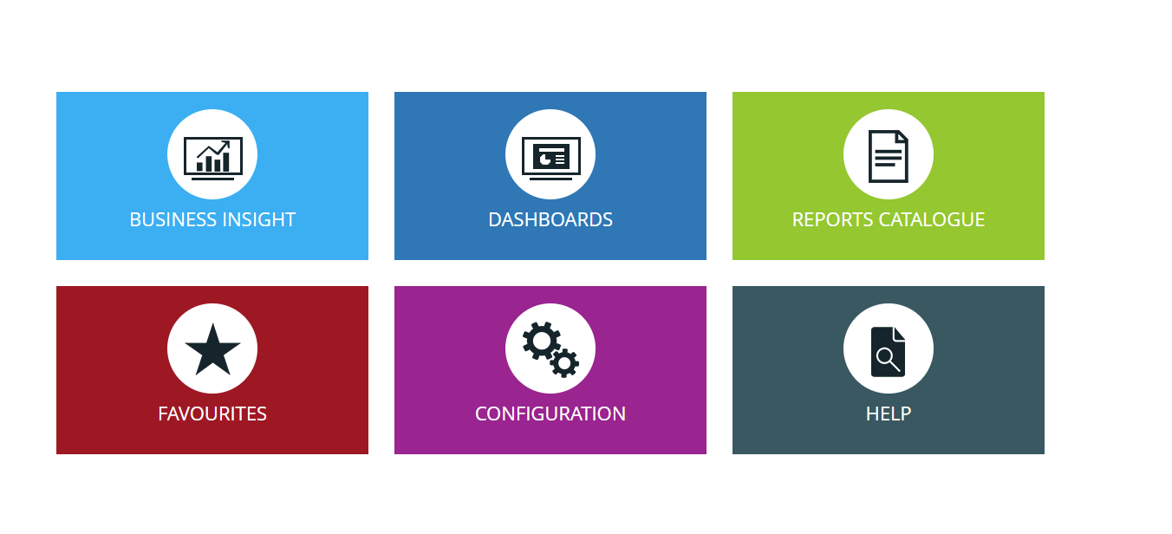
iCALL Extensions
To check how extensions are labelled log into the customers account on the icall portal
Then select configuration:

Slide 4
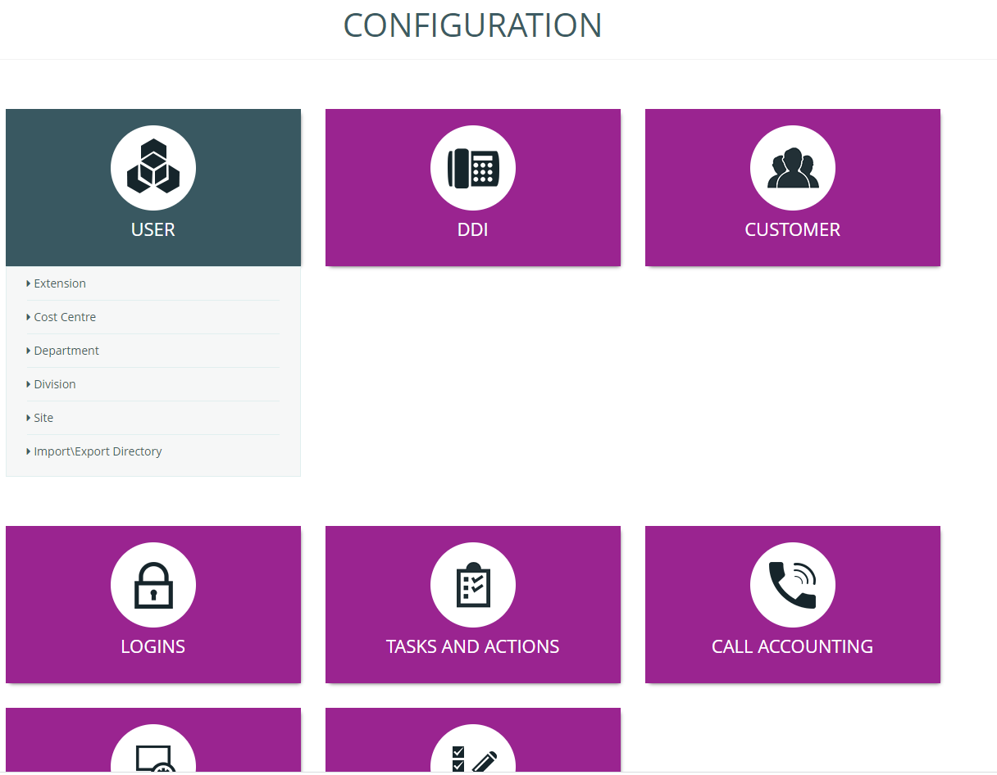
iCALL Extensions
Then select user and then extension:

Slide 5
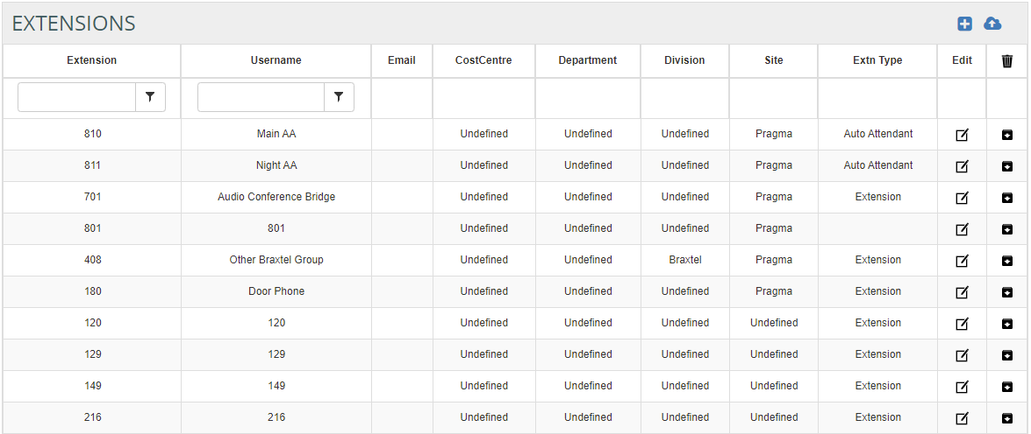
iCALL Extensions
This will show all live extensions and you can go through and check each extension is showing the correct extn type.

Slide 6
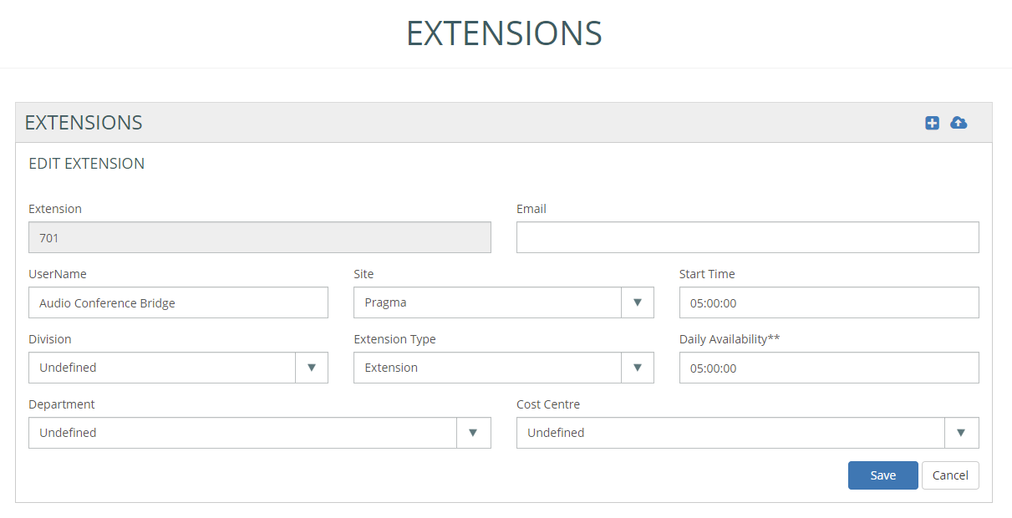
iCALL Extensions
Any extensions not require can be deleted and any that need to be corrected can be done by selecting the edit icon
next to the extension and change the extension type:

